Slide 1

WELCOME

Slide 2
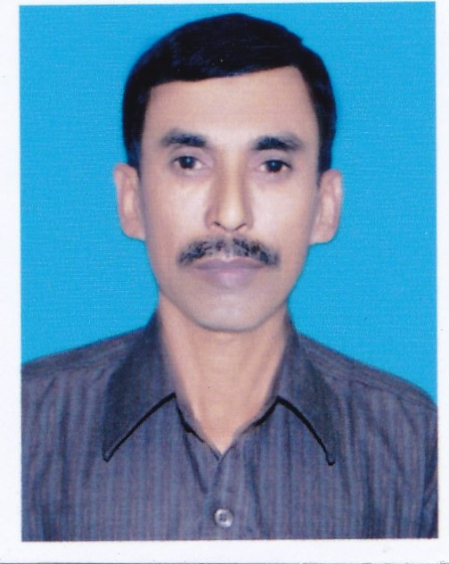
INTRODUCTION
Md. Abdul Mazed, Assistant Head Teacher
Goalbathan Seconsary School
P.O- Goalbathan, Magura Sadar, Magura.
Class Nine
Subject; English Second Paper
Unit
Lesson-
Noun
Time-50 minutes.

Slide 3
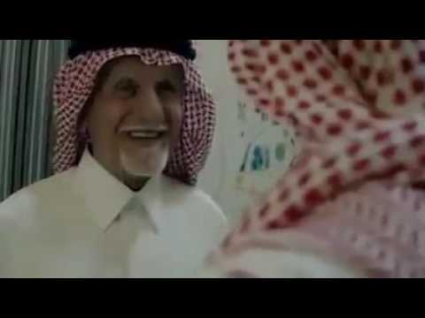
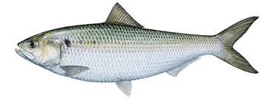
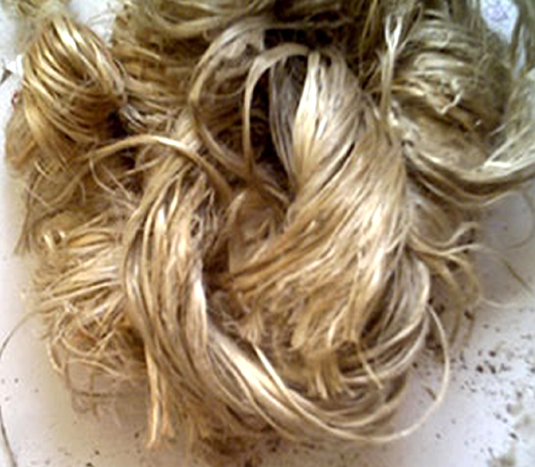
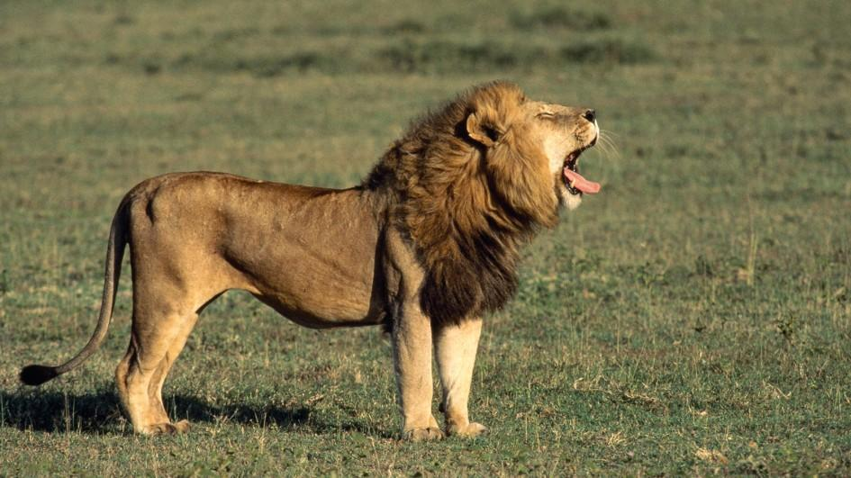
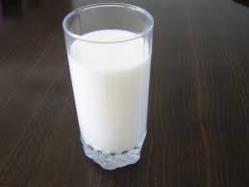
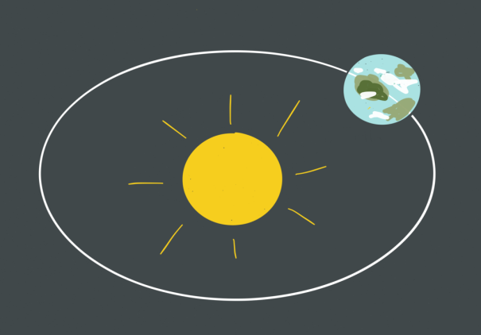
Look at the pictures and try to understand
Fish
Jute
Man
Earth
Lion
Milk

Slide 4
LEARNING OUTCOMES
The students will have
*learnt what noun is.
*learnt about five kinds of nouns.
*learnt the uses of five kinds of nouns.

Slide 5
Noun is the name of a person , a thing, a place, a work, a condition and a quality.
Noun is of five kinds. They are;
1.Proper Noun
2.Common Noun
3.Collective Noun
4.Material Noun
5.Abstract Noun

Slide 6
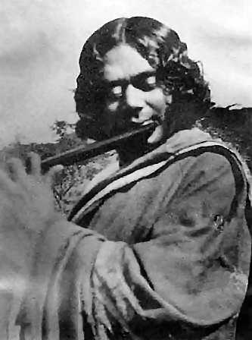
Look at the pictures and try to understand;
Kaji Nazrul Islam is our national poet.

Slide 7
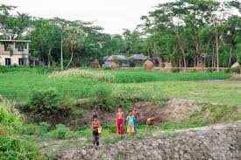
Rupgonj is a big village.

Slide 8

The Quran
The Quran is a holy book.

Slide 9
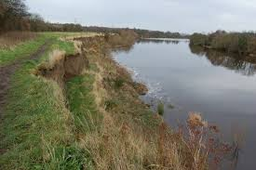
The Padma is a big river.

Slide 10
Proper noun is the name of a particular person, a thing, a place or an event.
EXAMPLES;
Rahim, Dhaka, The Himalays, The Sun. The Moon.The Quran, The Meghna,The Bible, The Bangladesh Liberation War, The
Tajmahal, The Earth, Shakespeare , Bangladesh etc.
EVALUATION
Fill in the gaps with appropriate proper nouns;
1.--------is our motherland.
2.The-------rises in the east.
3.The------is a big river.
4.We visited the-------last year.
5.The------moves round the sun.

Slide 11
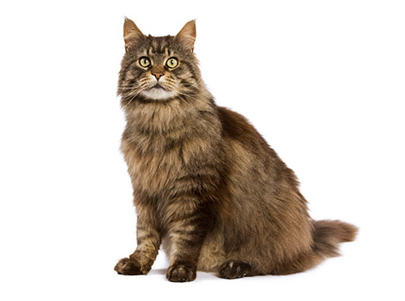
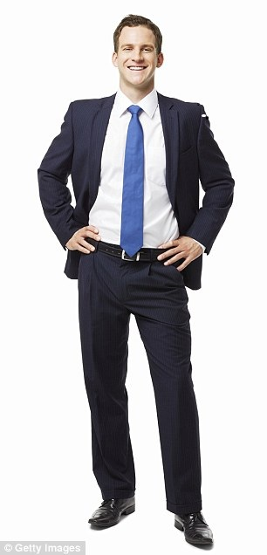

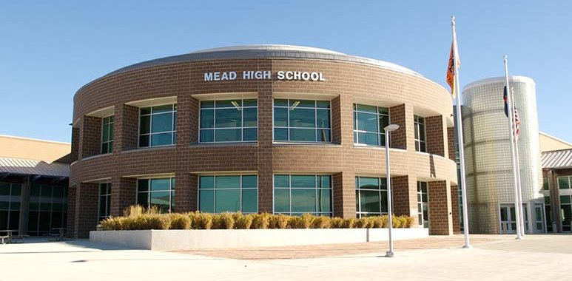
Look at the pictures and try to understand;
Lion
cat
Cow
School
Man
Student

Slide 12
A Common Noun denotes a name which is common
to every person, place or thing of the same kind or class.
EXAMPLES
Man. Boy, Girl, Cow, Cat, river, student, school, deer, lion, bird
Father, mother, flower, city , town, village etc.
EVALUATION
Fill in the gaps with common nouns;
1.London is a famous--------.
2. The-------is a useful animal.
3.The--------is a beast of prey.
4.--------is mortal.
5.The Meghna is a big-------.

Slide 13
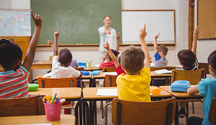
Look at the pictures and try to understand;
A class of students

Slide 14
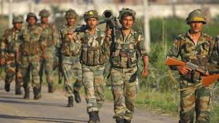
The army is going to fight.

Slide 15
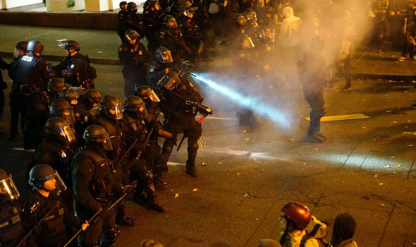
The police is using tear gas.

Slide 16
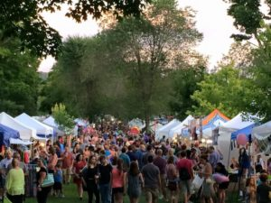
A crowd of people is gathering here.

Slide 17
A collective Noun is the name of a group or collection of persons or things of the same class taken as a whole.
EXAMPLES; people, class, club, committee, crowd, army, family, council, police, parliament, Jury, Board ,Audience etc.
EVALUATION
Fill in the gaps with collective nouns;
Jury, committee, police, Audience
1.He is on the--------------.
2.The -------arrested the murderer.
3.The ---------heard her songs.
4.The -------were divided in their opinions.

Slide 18
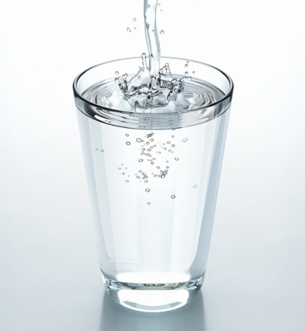
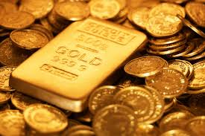
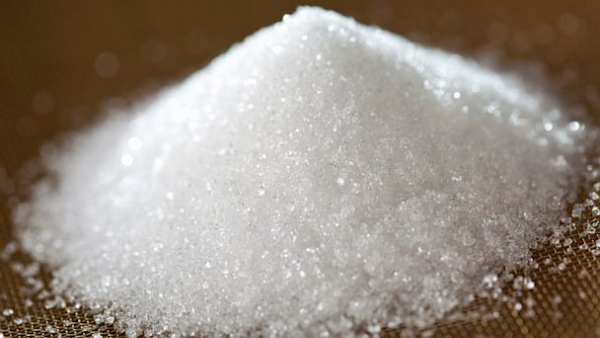
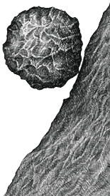
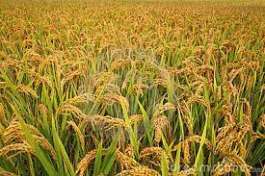
Look at the pictures and try to understand
water
Gold
Sugar
Jute
Stone
Paddy
Milk

Slide 19
A Material Noun denotes the matters or substances of which things are made.
These things are not countable.
EVALUATION
Fill in the gaps with Material Nouns;
Gold, iron, milk, water, jute
1.------is a useful metal.
2.------is an ideal food.
3.We can not live without--------.
4.-------a precious metal.
5.--------is exported to foreign countries.

Slide 20
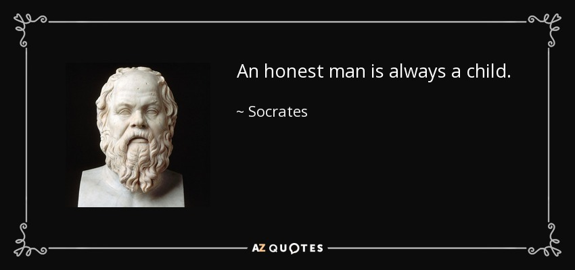
Look at the pictures and try to understand;
Honesty is the best policy.

Slide 21
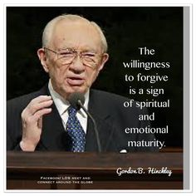
Forgiveness is divine.

Slide 22
Youth is the most precious time of life.

Slide 23
An Abstract Noun is the name of a quality, condition,
action or property belonging to a person or a thing.
EXAMPLES;
Honesty, Goodness, Childhood, Truthfulness, poverty,
Youth, walking, sleeping, kindness, wealth,Justice etc.
Fill in the gaps with Abstract Noun;
1.----is a good exercise.
2.-------is a great problem in our country.
3.------a great virtue.
4.-------is the best policy.
5.------is the most precious time of life.

Slide 24
Uses of Nouns;
1.As the subject of a verb; Mr. Khan teaches us English.
2.As the object of a verb ; I know Mr. Khan.
3.As the object of a preposition ; The cat is fond of milk.
4.As a complement to verb ; He is a good student.
5.Noun or case in Apposition; Mr. Khan, Headmaster of this school is a good man.
EVALUATION
Fill in the gaps with appropriate nouns;
1.The-------lives on grass.
2.-----is a great virtue.
3.------a good exercise.
4.-------is the best policy.
5.We visited the-------last year.
6.His father is on the------.
7.A big------gathered in the market.
8.------is a precious metal.

Slide 25
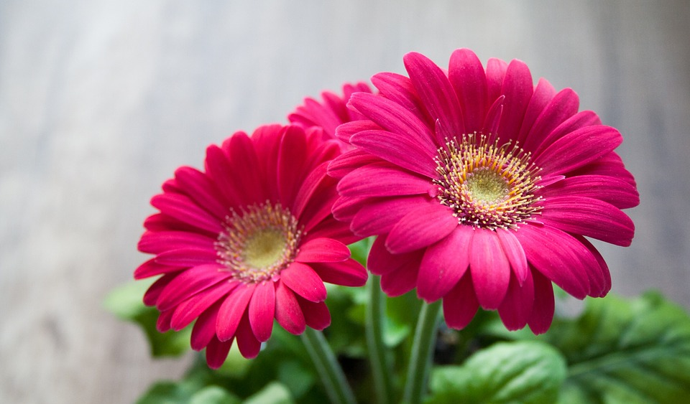
HOME WORK
Write five sentences by using five kinds of nouns;
THANK YOU

